Slide 1
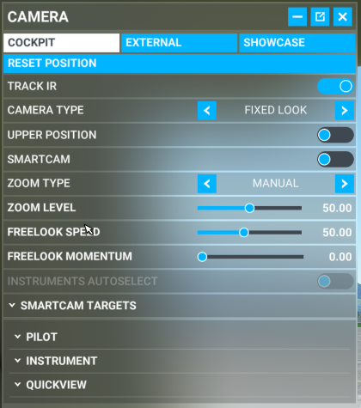
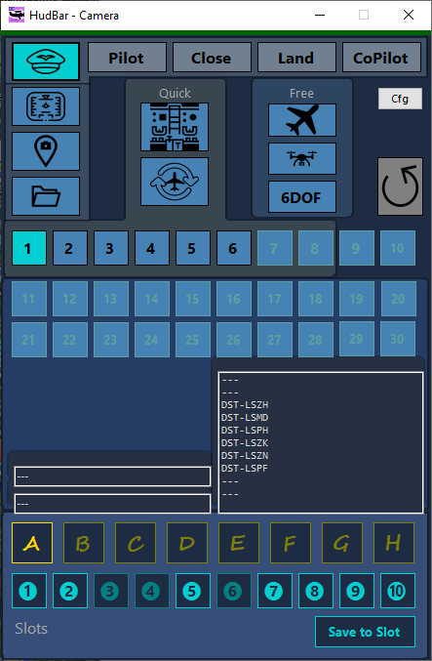
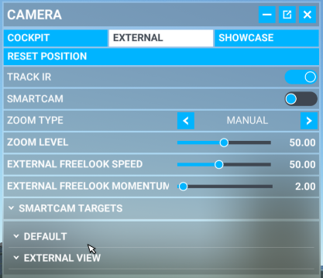
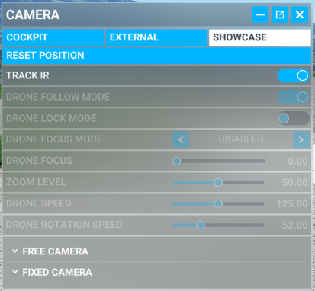
SmartCam

Slide 2
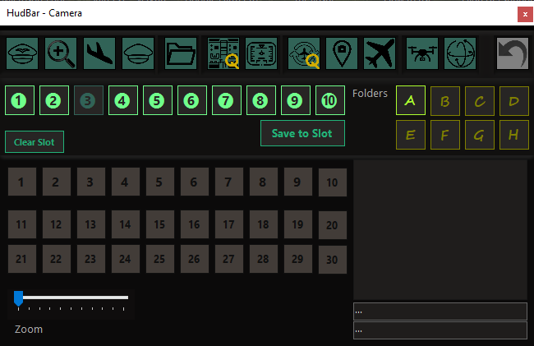
SmartCam

Slide 3
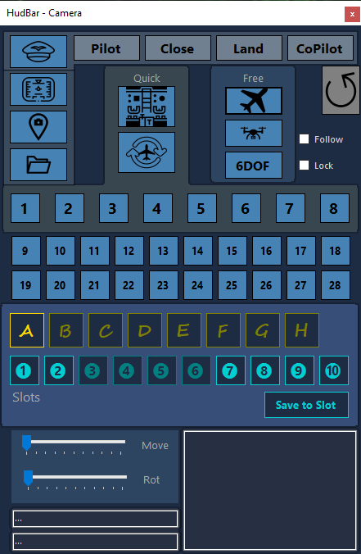
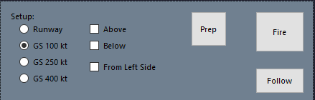
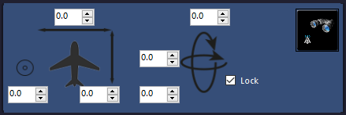
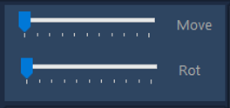
BASE
DRONE
6DOF
ZOOM
ZOOM

Slide 4
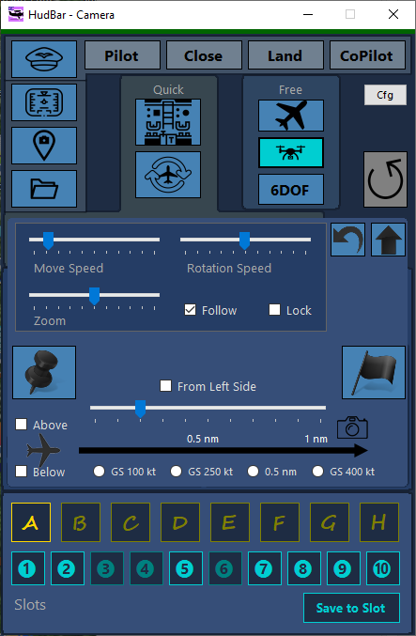
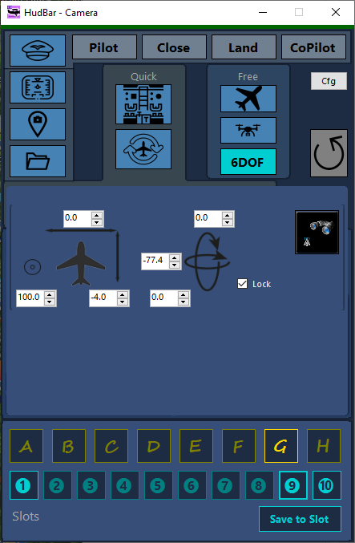

Slide 5
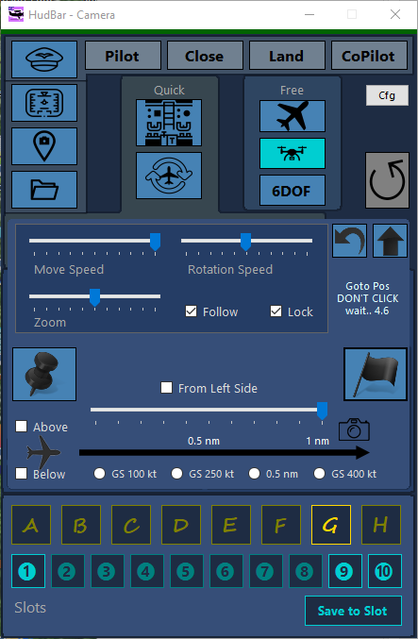
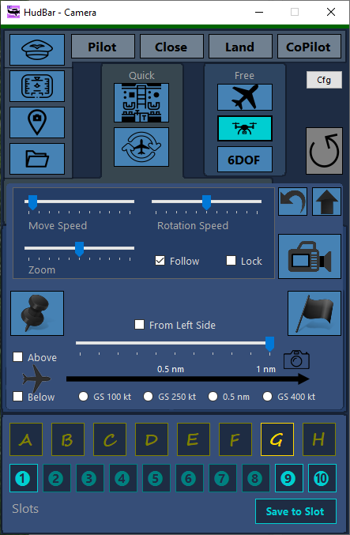

Slide 6


Reset Drone Cam
Check ‘Follow’ and ‘Lock’ ON
Move Drone Forward (hold W key) – note the cam will switch and look backward to the aircraft
With Drone speed 30 it will take about 60 seconds to move 1 nm
Move the cam to an offset of the track (short A, D, R, F key press) As the cam is locked it always points to the aircraft.
In order to trigger the flyby Uncheck ‘Follow’

Slide 7
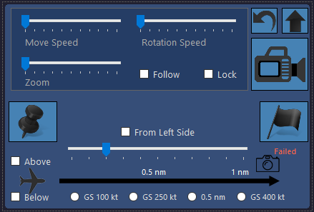
Init just in front of the aircraft use Move Backward (S) and sideways (A,D,R,F) to position the camera This is mostly usable when on ground.
Reset Drone Cam
Follow the aircraft
Release the fly by will uncheck ‘Follow’
Set the camera position in front of the aircraft
Init at a distance in front of the aircraft This is mostly usable when in air.

Slide 8
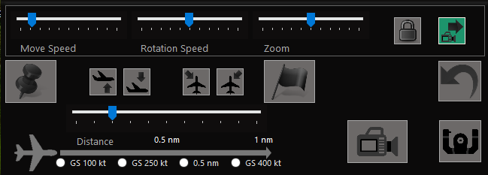
Init just in front of the aircraft use Move Backward (S) and sideways (A,D,R,F) to position the camera This is mostly usable when on ground.
Lock view towards the aircraft (green is active)
Follow the aircraft
(green is active)
Reset Drone Cam
Toggle Steering mode
(green is active – see note)
Release the fly by will uncheck ‘Follow’
Set the camera position in front of the aircraft
Init at a distance in front of the aircraft This is mostly usable when in air.

Slide 9
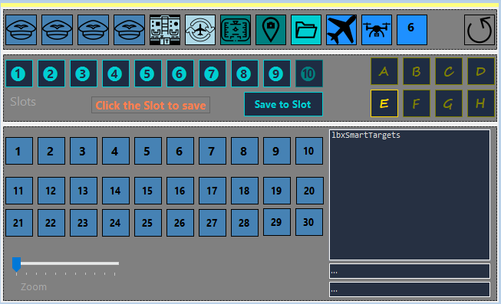
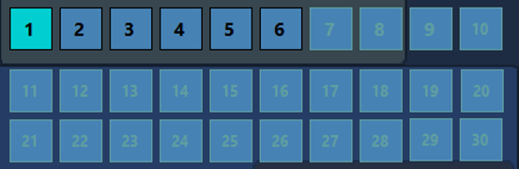
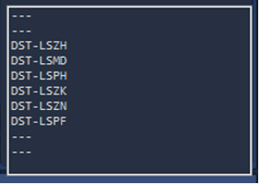


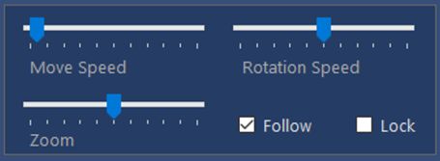
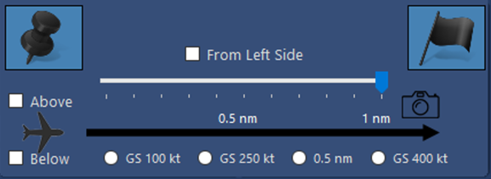
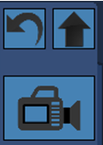
Pilot
Close
Land
FO
Q Inst
Q
Ext
Inst
Ext
Cust
Drone
Ext
6D
1
2
3
4
5
6
7
8
9
10
A
B
C
D
Save Slot
E
F
G
H

Slide 10
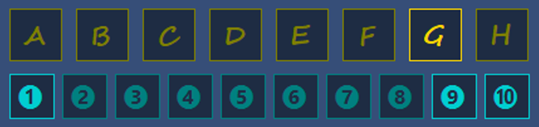
9
10
11
12
13
14
15
16
18
19
20
21
22
23
24
1
2
3
4
5
6
7
8
17
Pilot
Close
Land
FO
Q Inst
Q
Ext
Inst
Ext
Cust
Drone
Ext
6D
1
2
3
4
5
6
7
8
9
10
A
B
C
D
Save Slot
E
F
G
H
A
B
C
D
E
F
G
H
1
1
1
1
1
Save Slot
1
1
1
1
1
A
B
C
D
E
F
G
H
Save Slot
1
1
1
1
1
A
B
C
D
E
F
G
H

Slide 11
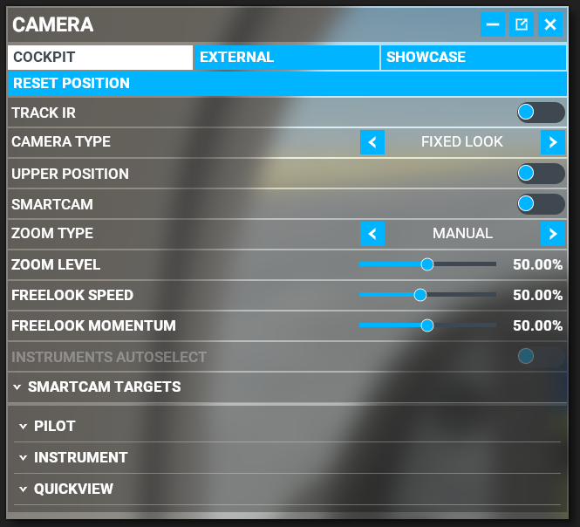
State
SubState
ViewType
Cockpit
External
Drone
Drone Plane
Ground
ShowCase
Locked
Unlocked
QuickView
Smart
Instrument
Default
Pilot
Instrument
Quick
External
Other

Slide 12
NAV1
KASDJS (VOR)
GPS
KASDJS (VOR)
123.22
123.22
123.22
123.22
NAV1
123.22
123.22
Đ KASDJS (VOR)
DIS DTK BRG
DIS DTK BRG
NAV2
123.22
123.22
KASDJS (VOR)
_.__ ___ ___
_.__ ___ ___
DME
123.22
123.22
0.0 ___ __:__
0.0 ___ __:__
ADF1
123.22
123.22
ADF2
123.22
123.22
GS TRK ETE
GS TRK ETE
COM1
123.22
123.22
COM2
123.22
123.22
. . . . . ^ . . . . .
X
. . . . . ^ . . . . .
. . . . . ^ . . . . .
X
X
Tx off
7700
FROM

Slide 13
TOP
BAR
WINDOW
R
I
G
H
T
L
E
F
T
WINDOW NO BORDER
TILE
BOTTOM

Slide 14
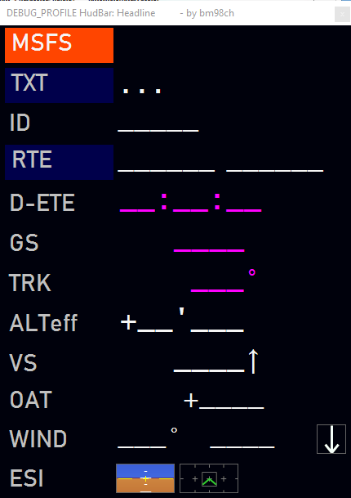
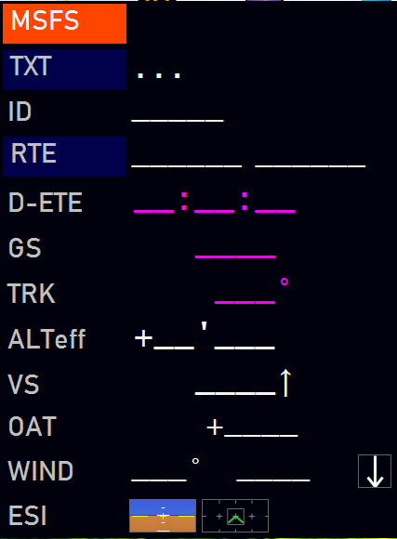
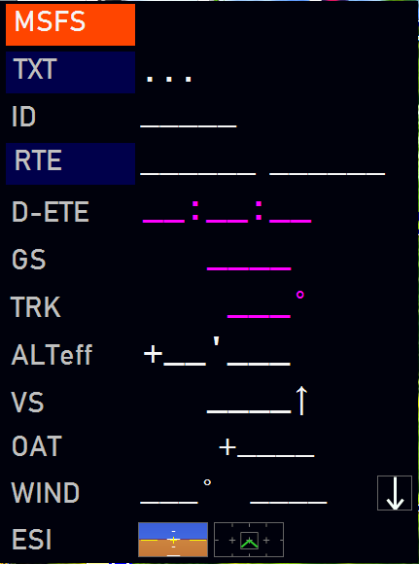
TOP
Bar - Top
R
I
G
H
T
L
E
F
T
Window – Left/Right
Tile - Left
Window no border – Left/Right
Tile - Bottom
BOTTOM

Slide 15
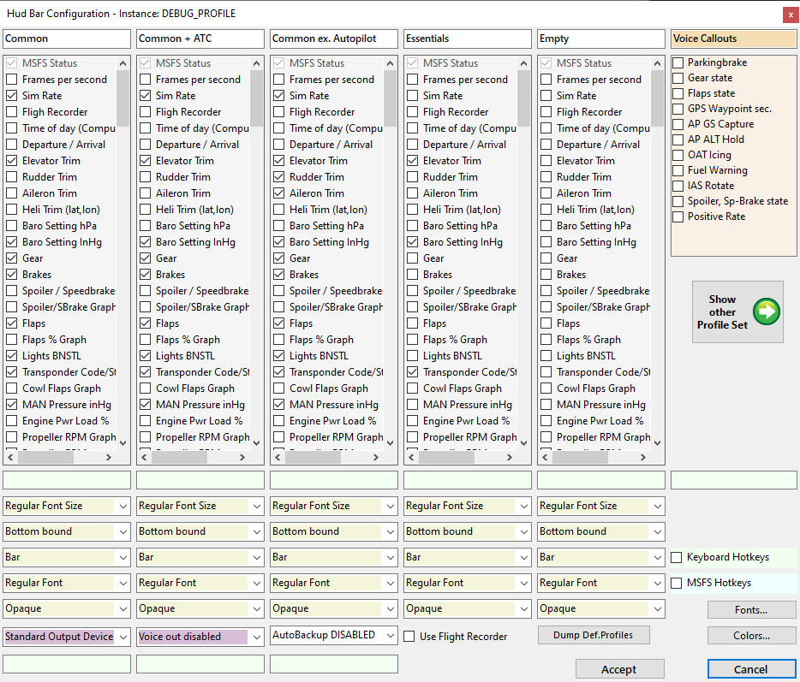
Tab
Callouts
Hotkeys
Keyboard
MSFS
HK ShowHide
HK FlightBag
HK CamCtrl
HK Checklist
FontSize
Condensed
Opacity
Bar
Top bound
Hotkey
BackgroundFile
…
Output Device
Backup
Fonts…
Voice
Recorder
Colors…
Accept
Cancel

Slide 16
-10
-8
-5
-2
0
2
5
8
10
-10
-8
-5
-2
0
2
5
8
10

Slide 17
-10
-5
0
5
10
-10
-5
0
5
10

Slide 18
-10
-5
0
5
10
-10
-5
0
5
10

Slide 19
-10
-5
0
5
10
-10
Ellipse (-3,-9, 6,13)
Line (2p, -6,-10,6,3)
Line (2p, 6,-10,-6,3)
Pt(-1,3)
Pt(-1,7)
Pt(-5,9)
Pt(-4,10)
Pt(0,9)
Pt(4,10)
Pt(5,9)
Pt(1,7)
Pt(1,3)
-5
0
5
10

